Slide 1
Tableau to SF
AI-Powered Analytics Platform Modernization Accelerator
[Tableau to Power BI]
Back

Slide 2
TABLEAU → STREAMLIT IN SNOWFLAKE
Tableau Dashboards, Rebuilt Natively in Snowflake
Modernize the existing analytics stack, dashboards, running on the data Snowflake already holds
THE CHALLENGE TODAY WITH TABLEAU
TRADITIONAL SOLUTION
TABLEAU → STREAMLIT IN SNOWFLAKE
Licences on top of Snowflake
Renew, and keep paying
Dashboards move to what you own
Creator and viewer licences billed per user, every year, for a presentation layer sitting on data Snowflake already holds.
The licence renews because the dashboards live there. Cost grows with every viewer added.
Streamlit is already part of Snowflake. The same dashboards run with no BI licence underneath them.
A specialist skill to hire for
Hire or contract more of it
Your data team already has it
Tableau development is its own discipline — its own hiring line, contractors, and a handoff on every model change.
Capacity is bought in and the dependency deepens with each new dashboard.
Streamlit is Python. The engineers already on the platform own the whole path, table to dashboard.
A seperate platform to run
Maintain both, indefinitely
One platform, one set of roles
Another environment to host, upgrade and support, with access rules re-implemented away from the data.
Two platforms, two governance models, two support lines, permanently.
Serverless inside Snowflake, governed by the roles already managed there.
The dashboards were never the problem — the platform underneath them was. Snowflake already stores the data, runs every query, and now hosts the dashboards and the AI as well. The one thing that kept the BI tool in place was the cost of rebuilding what it holds..
Notes:
This is a cost conversation. Three recurring costs: the licence, the specialist skill, and the second platform. The middle column is what most customers actually do — renew, hire more, and maintain both — which changes nothing. Only the third column removes the spend rather than moving it.

Slide 3
AI-Accelerated Migration, With Human in the loop
Five stages, executing inside the customer's own Snowflake account
Stage 1
Stage 2
Stage 3
Stage 4
Stage 5
Discovery
Model Extraction
Cortex Translation
Semantic + App
Cortex Validation
Datasources resolved, data extracted, tables created and loaded in Snowflake
The workbook's semantic and presentation model is lifted out of the source
Cortex AI converts the complex calculations — nested LODs, blended measures — into Snowflake SQL
A native semantic view is created and the dashboard is generated as a Streamlit app
Tableau and Streamlit outputs are compared measure by measure, and the evidence is emitted
Streamlit in Snowflake | Cortex AI (Claude Opus 4.8) | Cortex Analyst | Native Semantic Views | Snowpark
Human-in-the-Loop
Everything Runs In-Account
Every Cortex-proposed translation is executed against the real table first, then enters a reviewer's queue — accept, amend or reject. Every decision is recorded and auditable.
Cortex calls, semantic view creation, table loads and the finished dashboard all execute on Snowflake compute under the customer's own roles. No data leaves the account.
Assessment first: before any conversion, the workbook is scanned and a migration-readiness report is produced — what converts, what needs attention, and where the effort sits.
Notes:
Cyan-bordered stages are where Cortex does the work — three of the five. Human-in-the-loop is an enterprise control, not a caveat: the AI proposes, it is proven against real data, a person signs it off, and the decision is audited. Mention assessment — a customer can see what a migration involves before committing to it.

Slide 4
What Cortex Does
Claude models running inside the customer's Snowflake account
1
2
3
4
Translates the complex calculations
Builds the governed semantic model
Serves natural-language questions
Validates the migration
Nested level-of-detail expressions and blended, cross-source measures become Snowflake SQL — then execute against the real table to confirm they run and return the right values.
The workbook's verified measures become a native semantic view: Tableau measures as Snowflake metrics, business captions as synonyms, identifiers read from the live tables.
Cortex Analyst answers business questions over that same governed model, so exploration uses the definitions the migrated dashboards already use.
Cortex reads the source workbook and compares it against the generated app section by section, producing the evidence pack that closes the migration.
Worked example — a calculation Cortex converted and proved
TABLEAU SOURCE
CORTEX OUTPUT
PROVEN
{ FIXED [Region] : AVG( { FIXED [Region],[Sub-Category] : SUM([Sales]) } ) }
WITH inner AS ( SELECT region, sub_category, SUM(sales) … ) SELECT region, AVG(v) …
4 of 4 region values exact
A nested level-of-detail expression — an average of an average, at two different grains.
Rewritten as layered CTEs that Snowflake executes directly.
Executed against the real table and checked against an independent ground truth before acceptance.
Notes:
Slow down on the worked example — it makes Cortex's contribution concrete: a genuinely hard Tableau construct, the SQL Cortex produced, and the fact it was executed and checked against an independent ground truth before anyone accepted it.

Slide 5
Impact
Faster time to value — and a migration the business can trust
90%+
Minutes
Every measure
Before you commit
converted automatically
from workbook to live app
tied out to the source
assessment comes first
The common majority of every dashboard — charts, calculations, filters and layout — without a developer rebuilding it by hand.
One run inside the Snowflake account, not a rebuild project measured in sprints and handoffs.
Validated automatically as part of the migration, with downloadable evidence rather than an assurance.
The estate is scanned and scored up front, so what converts — and what needs attention — is known before the work starts.
VALUE TO THE BUSINESS
VALUE TO SNOWFLAKE
Dashboards live in days, not development cycles
Warehouse compute on every dashboard view, where an extract served it before
The data team owns the whole path — no specialist queue, and no second platform to run
Cortex consumption on every workbook migrated
Governance stays with the data — access rules and row-level security inherited, not rebuilt
The semantic layer adopted as the governed model, feeding Cortex Analyst
Anything that cannot convert is surfaced up front, never discovered late
BI workload consolidated onto the platform, and share taken from a competing stack
An extract sends Snowflake no query workload at all
Tableau's own engine serves it, so those dashboard views never reach the warehouse. Migrated, every single view becomes warehouse compute and every migration becomes Cortex consumption — on data that never leaves the account.
Streamlit in Snowflake | Cortex AI (Claude Opus 4.8) | Cortex Analyst | Native Semantic Views | Snowpark
Notes:
Lead on speed and confidence, not savings — the cost argument is already made on slide 1, so this slide is about what the customer gets. The four headline cards are the value message: the majority converts automatically, a workbook becomes a live app in a single run, every measure is tied out with evidence, and the estate is assessed before anyone commits. Then show both value columns — the business case that wins the account on the left, and the reason to co-sell it on the right.

Slide 6
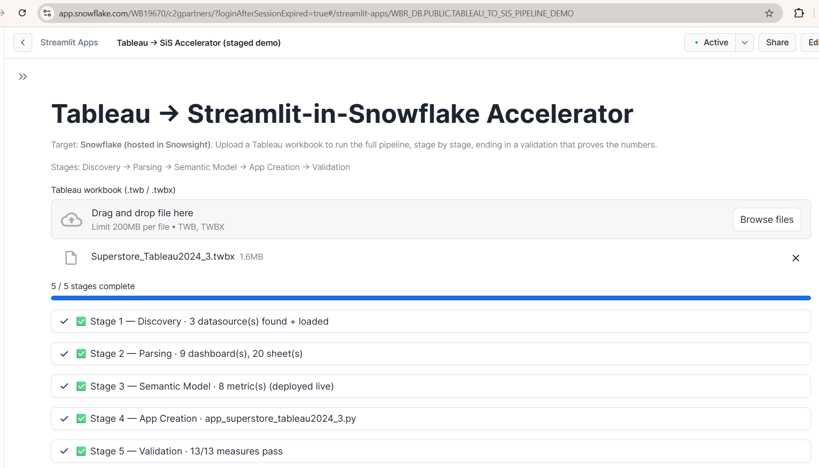
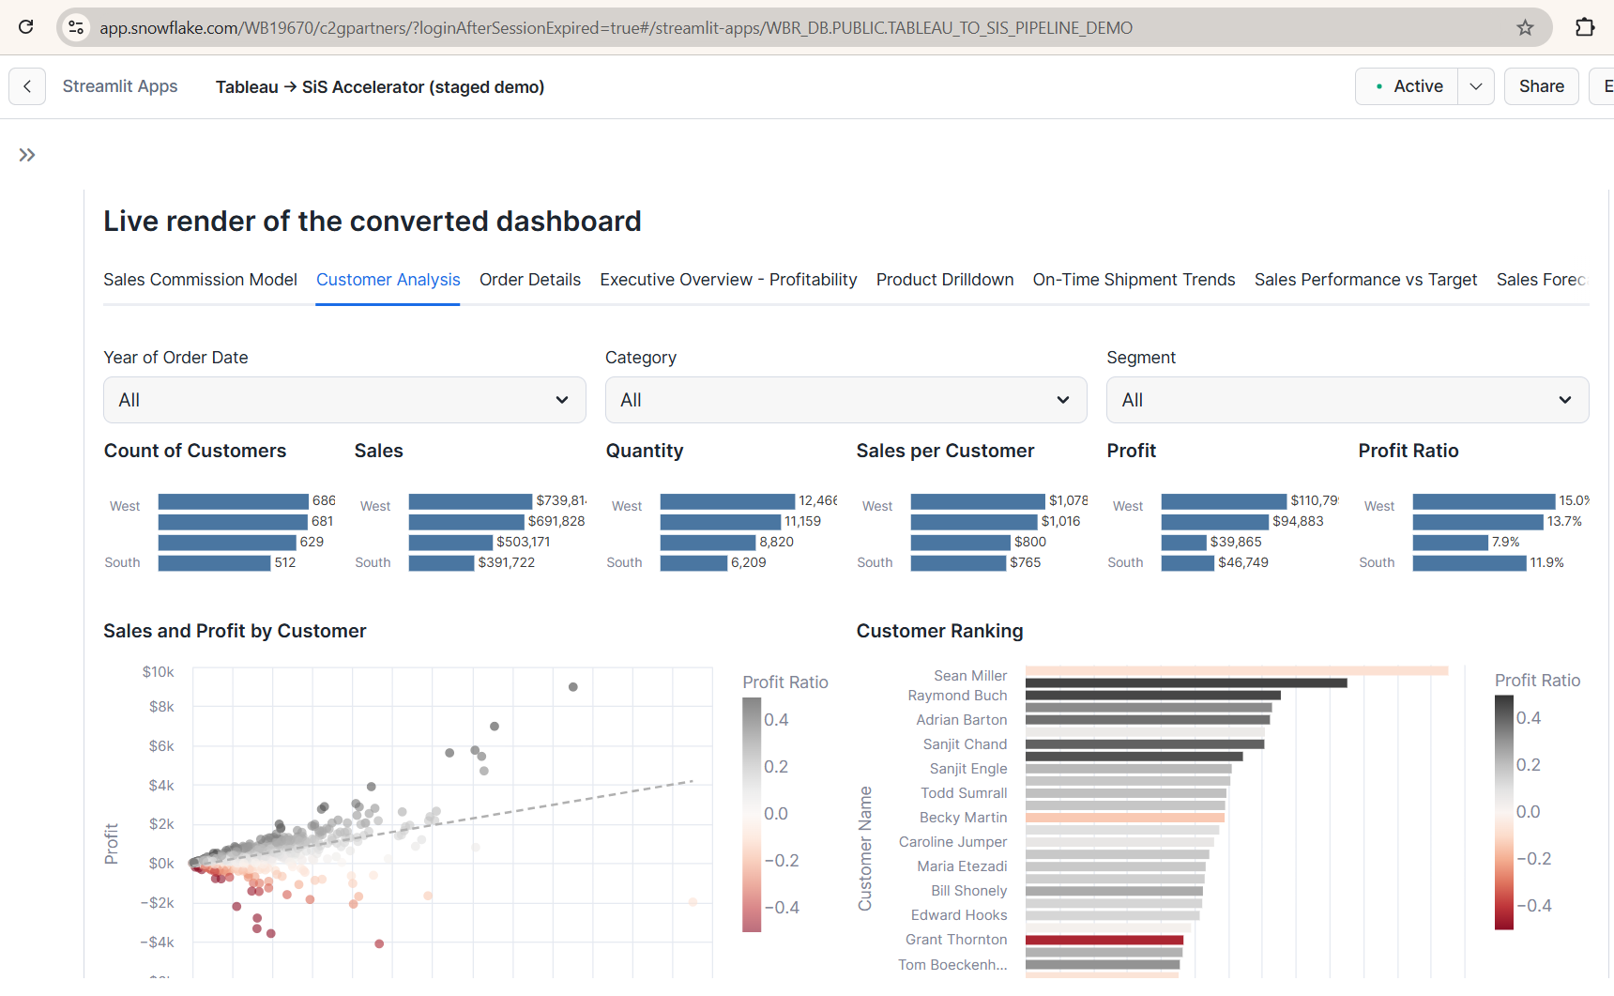
Running in Snowsight Today
One Tableau workbook, migrated end to end — hosted and executing inside Snowflake
The pipeline — five stages, executed in the account
The result — the converted dashboard, rendered natively
Superstore workbook uploaded · 3 datasources loaded · 20 sheets across 9 dashboards parsed · 8 metrics deployed as a native semantic view · 13/13 measures pass.
Nine dashboard tabs with their filters, KPIs, scatter and ranking charts — reading live from Snowflake tables, not a copy.
We would value your view. Which Snowflake capabilities are worth leaning on harder, and where this would be most useful in front of your customers. Every statement above is visible in Snowsight Query History with live timestamps.
Streamlit in Snowflake | Cortex AI (Claude Opus 4.8) | Cortex Analyst | Native Semantic Views | Snowpark
Notes:
These are real screenshots from the hosted app, not a mock-up — the Snowsight URL and chrome are visible in both. Land on the left image first: nine dashboards and twenty sheets migrated in a single run, ending in thirteen of thirteen measures tying out. Then the right: that is the converted dashboard rendering natively against Snowflake tables. If anyone questions whether it is genuinely executing in the account, open Query History alongside it. Close on the question and stop.

Slide 7
VIZLEAP
AI-Powered Analytics Platform Modernization Accelerator
[Tableau to Power BI]
Back

Slide 8
Why VIZLEAP
VIZLEAP
Manual migration is slow, risky, and inconsistent — VIZLEAP fixes that
THE CHALLENGE
THE VIZLEAP SOLUTION
Hundreds of Dashboards, Complex Calculations
Every visual and formula rebuilt by hand
Automated End-to-End Migration
AI handles extraction, modeling, and rebuild
No Documentation, Heavy SME Dependency
Tribal knowledge slows every handoff
Scales to Hundreds of Dashboards
Same pipeline, any portfolio size
Manual Validation Is Slow and Risky
Errors surface late; timelines slip
Reliable, Validated Outputs
Built-in QA ensures accuracy & consistency

Slide 9
How VIZLEAP Works
An automated four-stage migration pipeline
01
02
03
04
Metadata Extraction
Semantic Model Creation
Dashboard Creation
Quality Validation
Pulls complete Tableau server inventory information
Pulls dashboards, connection information, fields & calculations
Metadata report will be generated as csv and stored locally
Builds the Power BI model and DAX measures
Recreates visuals and layouts natively
Compares outputs to validate accuracy
50x
98%
4
Zero
FASTER MIGRATION
VISUAL FIDELITY
AUTOMATED STAGES
MANUAL REWORK
Lower delivery cost — Dashboard rebuild no longer requires dedicated analyst time
Minimal AI cost — LLMs powering the pipeline run at as little as $2 per dashboard.

Slide 10
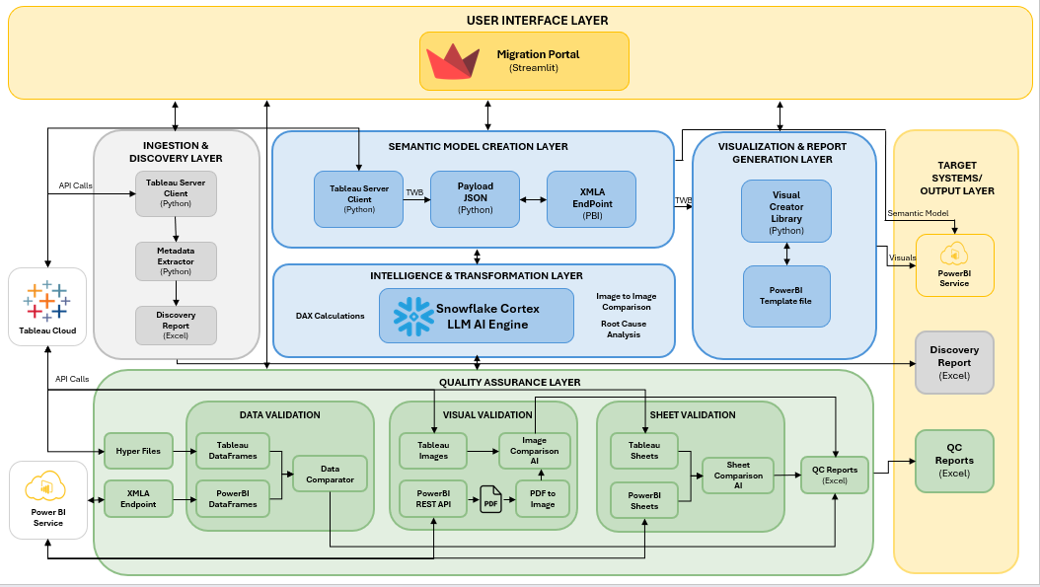
See VIZLEAP In Action
Ready to see the full migration pipeline live?
DEMO

Slide 11
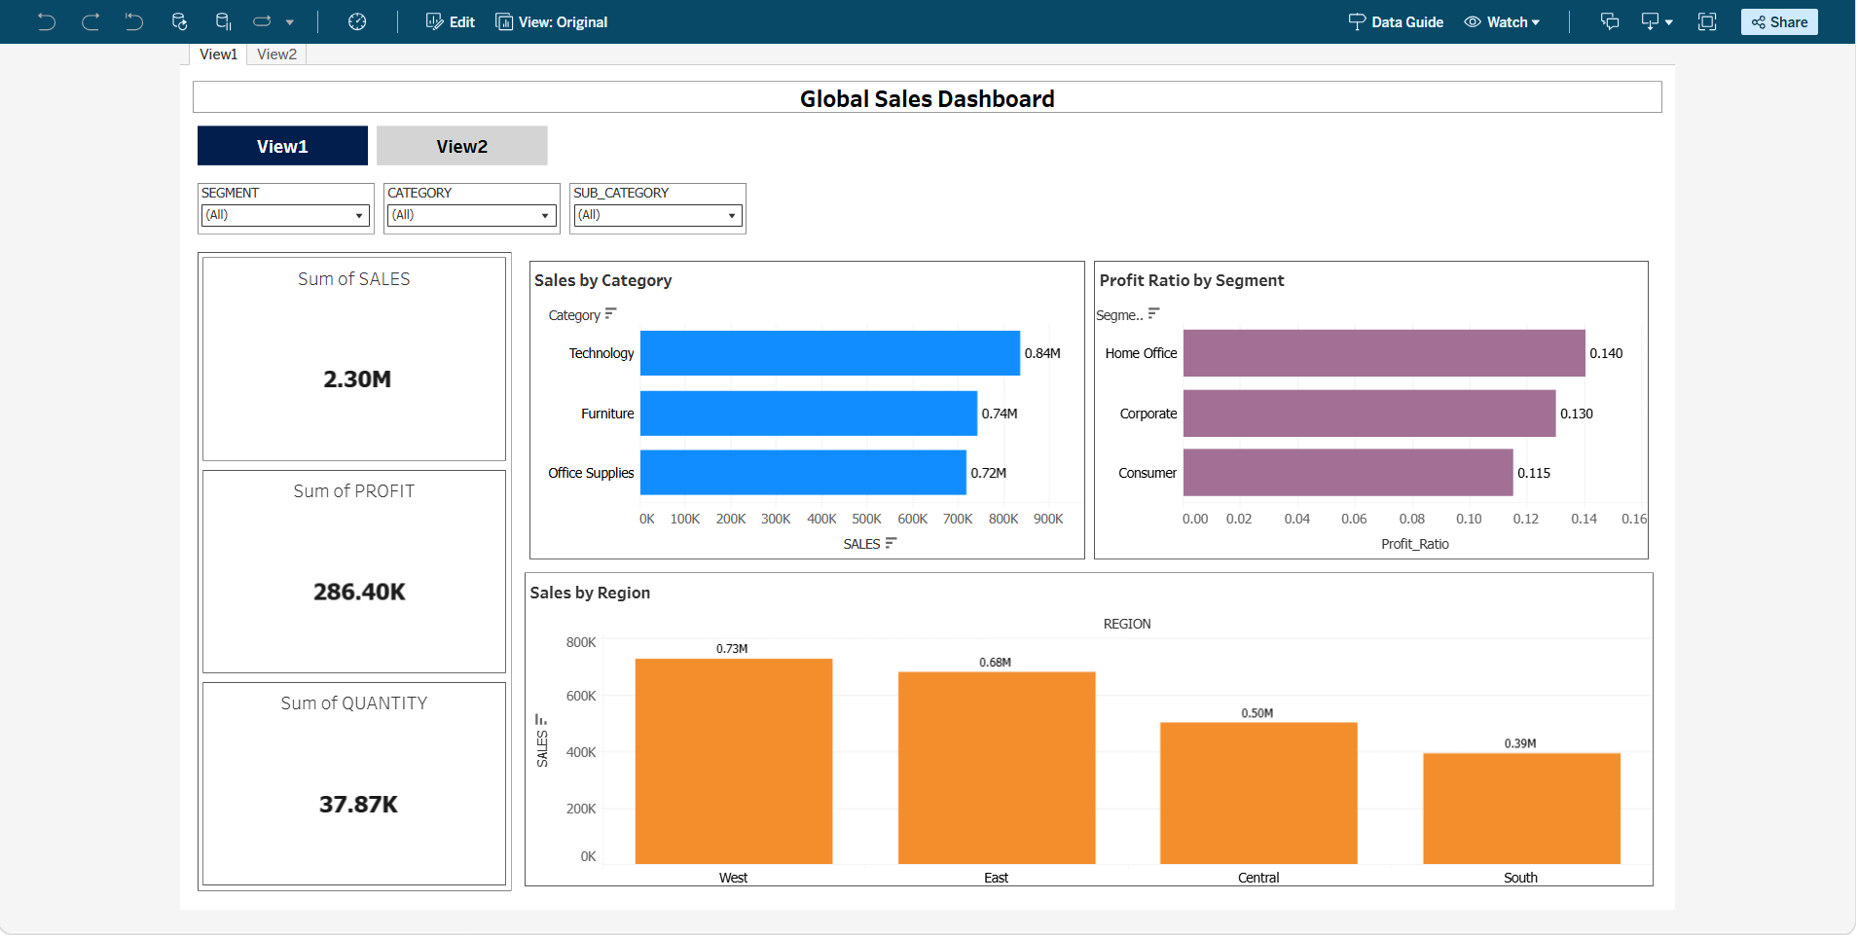
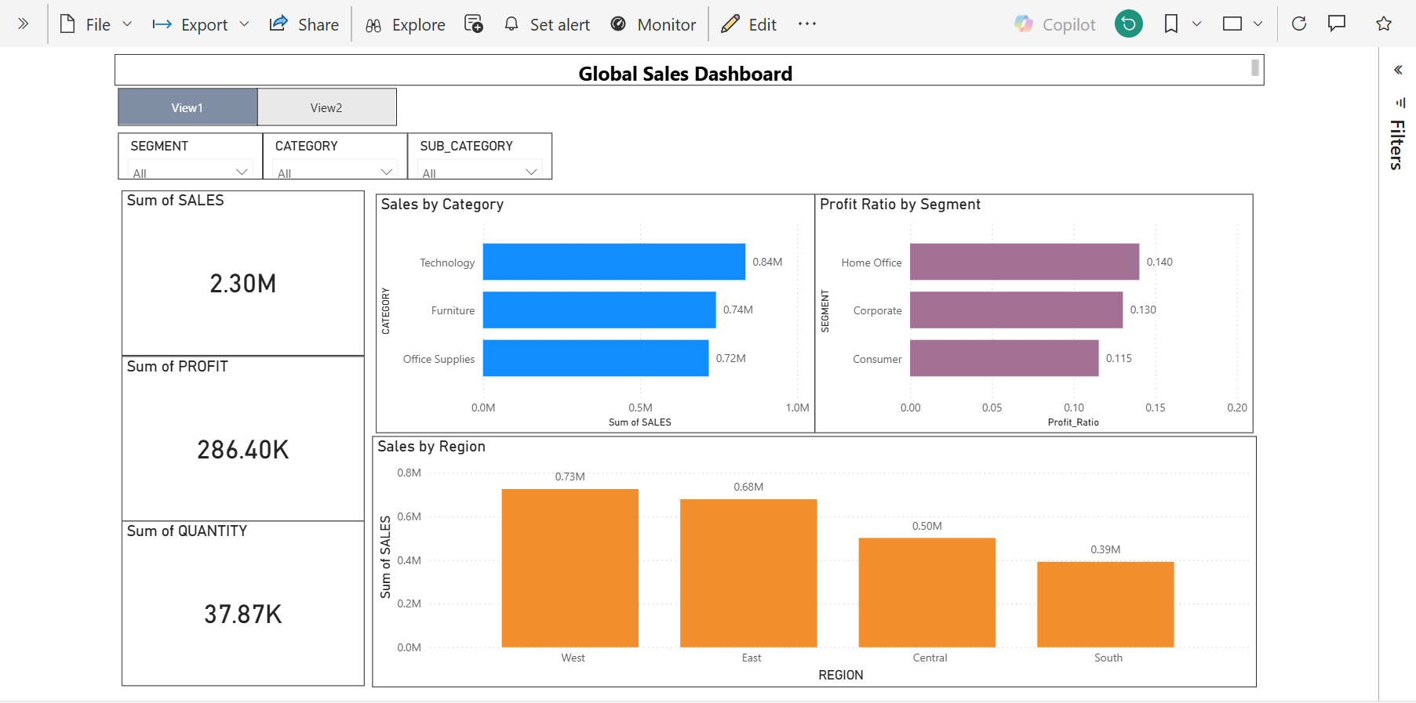
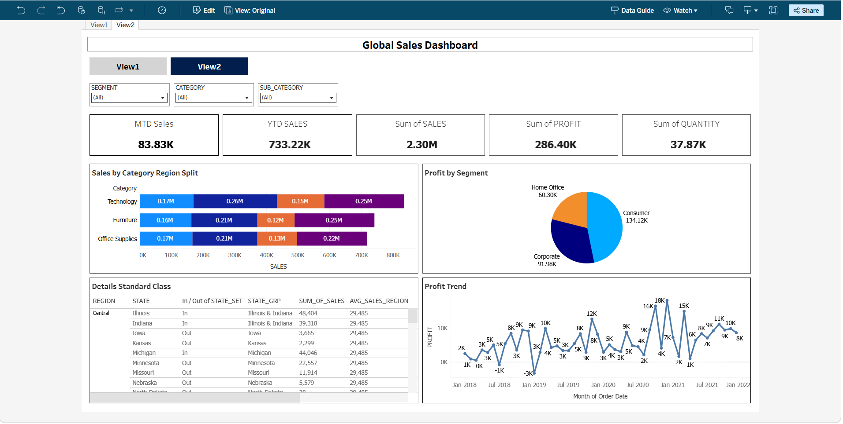
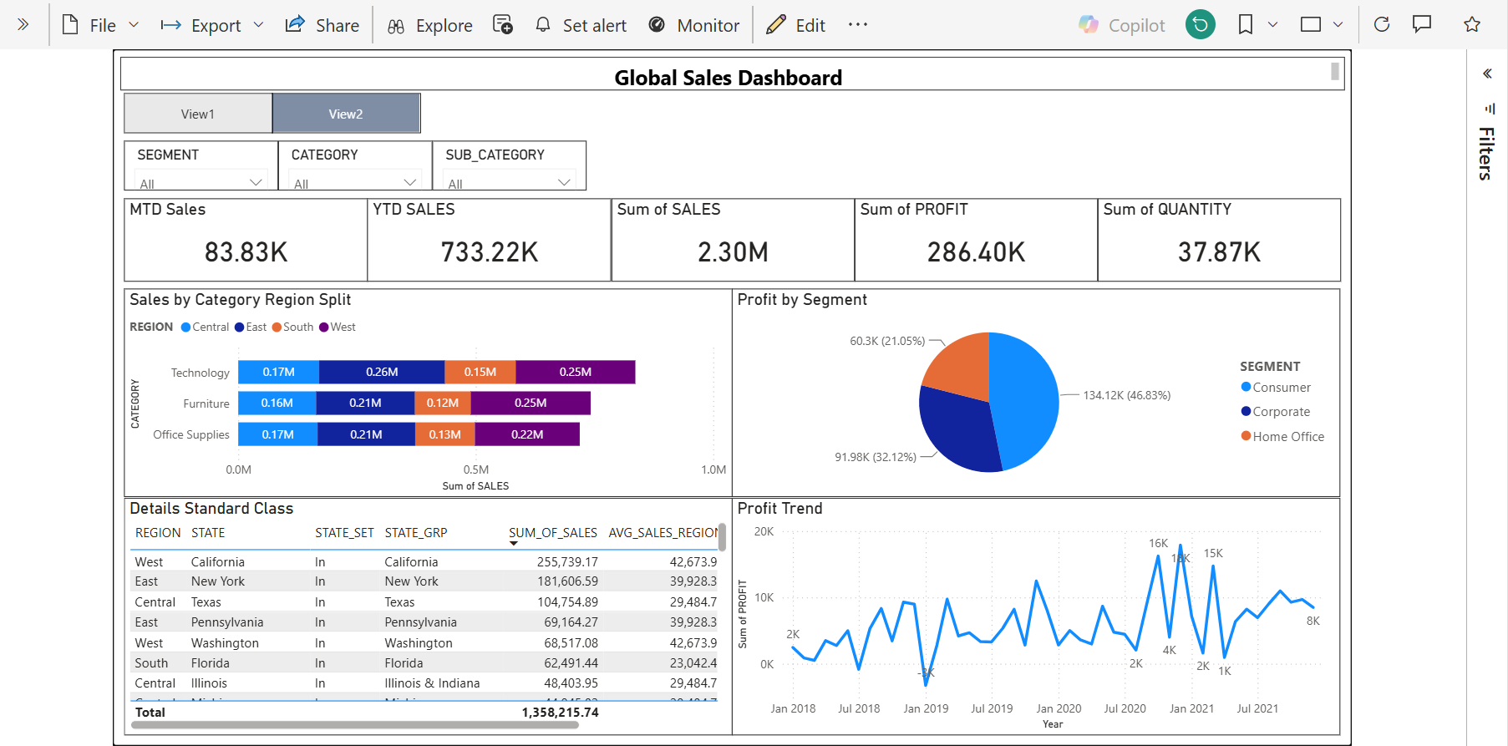
Tableau vs. Power BI: Dashboard Comparison
Tableau
Power BI

Slide 12
Built Natively on Snowflake
VIZLEAP's pipeline runs natively inside your Snowflake environment, powered by Snowflake Cortex AI
BUILT INSIDE YOUR ENVIRONMENT
Powered by Snowflake Cortex AI
The 4-stage pipeline, built natively inside your Snowflake tenant
Runs entirely within your environment
Powered by Cortex AI
All processing happens inside your Snowflake account.
Native LLM functions handle mapping, DAX, and validation.
Full data governance and control
No data movement
Your existing roles, policies, and security stay in force.
Dashboards and models are rebuilt in place, with zero data extraction.
You own the code
Enterprise-ready scale
We build the architecture; the deployed assets are yours.
Runs on Snowflake compute and scales elastically with demand.

